Slide 1
MTP Alchemist GUI Instruction
Ver0.0.1
Caesal Cheng 12/19/2024

Slide 2
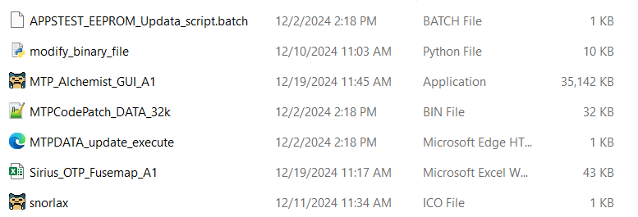
Preparing for MTP Almenist GUI
SharePoint address: MTP_Alchemist_GUI
Make sure you are downloading the latest version or the version you want to use.
Unzip the file and dont leave it in Download Folder, prefer location is in :C\
Make sure all the necessary files are included and under same folder as shown below
Don't modify the Excel file directly, it will mess up the structure. And all values have been updated to latest default value already.
Then, double click the Application to open it.

Slide 3
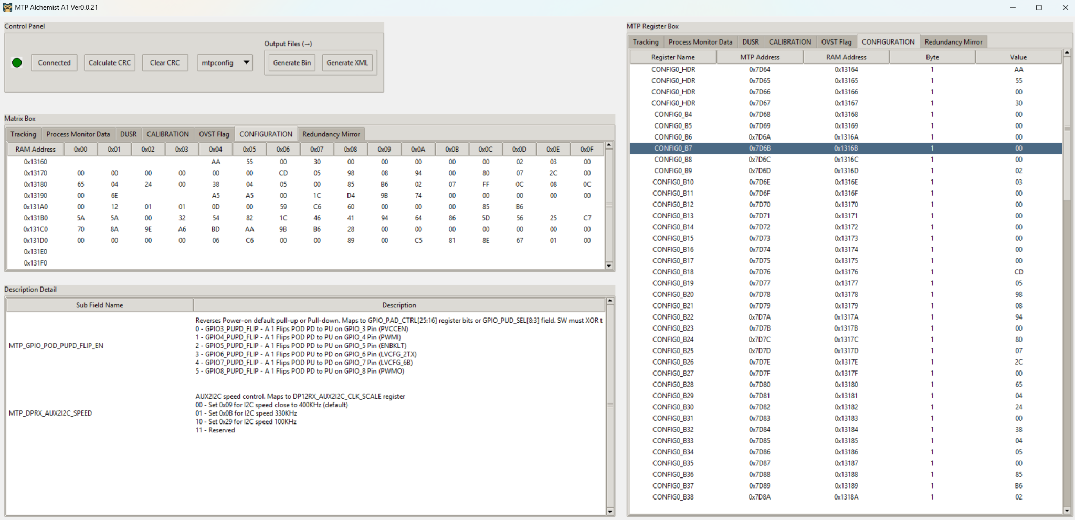
Interface for GUI

Slide 4
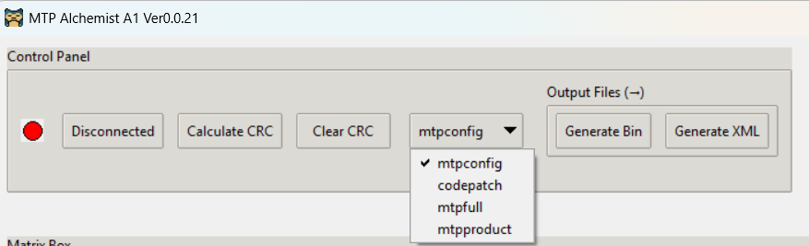
Control Panel
Generate CRC16 value for the tab you selected in register Box, Clear CRC16 value to blank
Ensure you calculate CRC16 for all tabs before you generate bin and xml files
Generate Bin at the same location as entire package located at, then click Generate XML file after Bin file generated.
Always connect excel file as first step, and recommend to disconnect before close GUI, close windows directly is also fine now.
Mtpconfig: CONFIGURATION Section Only
Mtpfull: Entire 0x13000 ~ 0x133FF (1KB)
mtpproduct: All sections before CONFIGURATION Section
Codepatch: Not Available for now, HW will take care

Slide 5
Interaction between each section in GUI
5 tabs under register box are available for editing: "Tracking", "Process Monitor Data", "DUSR", "CALIBRATION", "CONFIGURATION"
Double-click Value to update with new value, Matrix box will automatically update
Control Panel
Matrix Box is more obviously to see all values under each tab, you can simply see the CRC values leave as blank as default, fill out CRC by click Calculate CRC above
Double-click any register row in Register box, Description box shows detail information

Slide 6
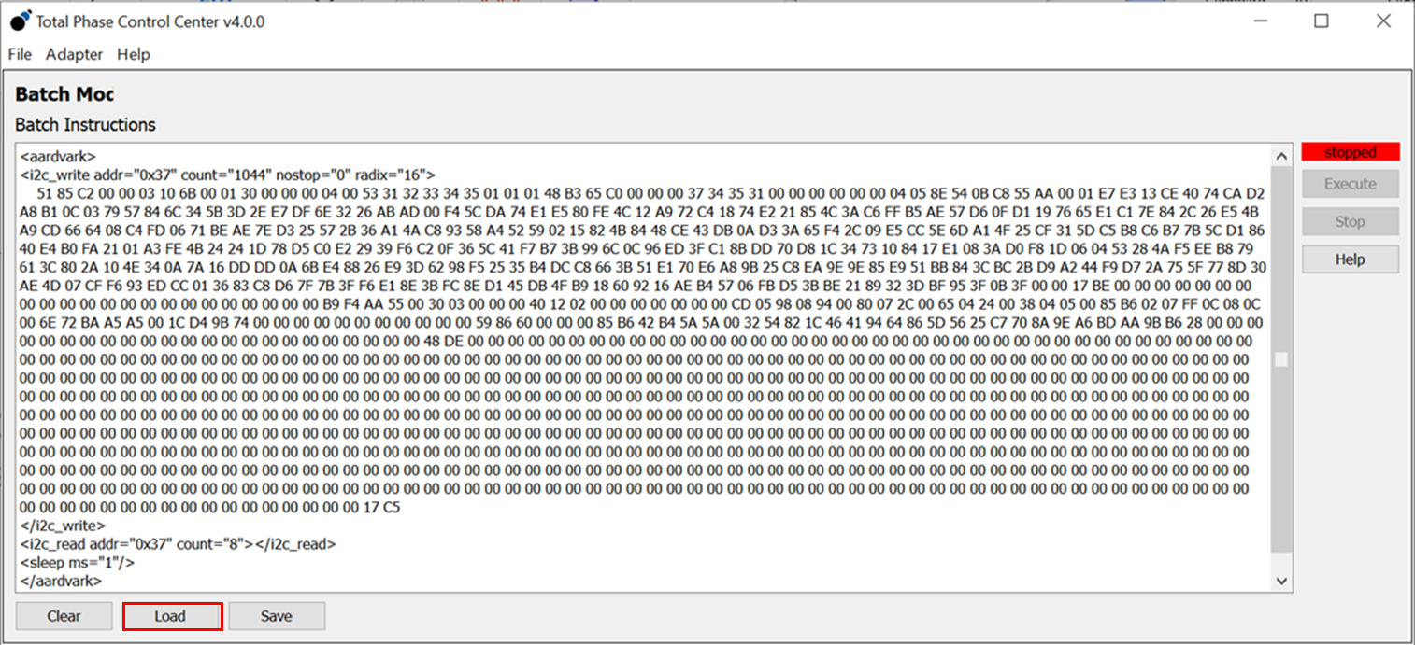
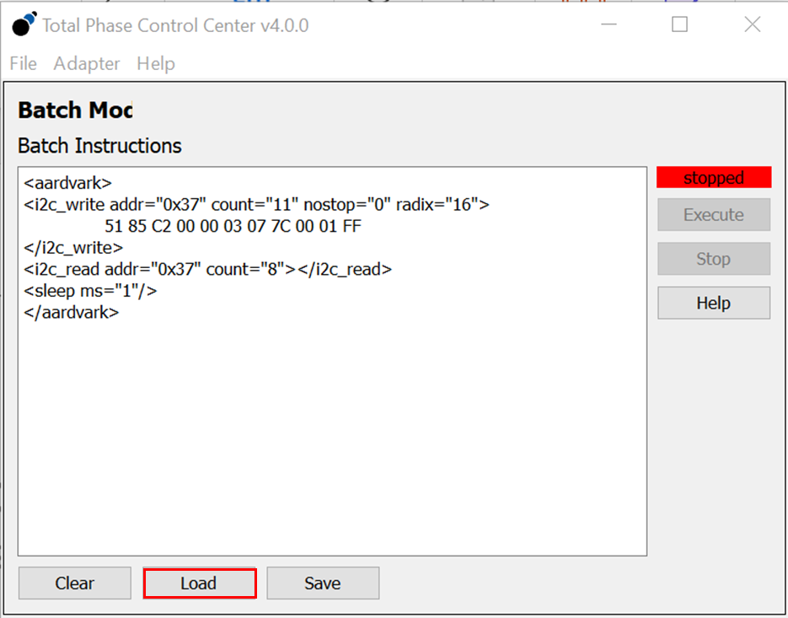
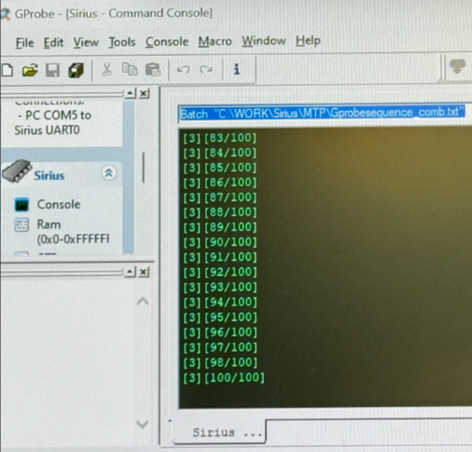
Update XML file into Sirius MTP
If use Aardvark to update, load the mtp_batch.xml file from Total Phase Control Center Adapter Batch Mode. Then hit “Execute” button after loaded.
NOTE: This step only writes the binary into Sirius’s SRAM memory for MTP. Yet updating to MTP.
After writing to Sirius internal memory is done, load the MTPDATA_update_execute.xml file from Total Phase Control Center Adapter Batch Mode. Then hit “Execute” button to start updating to MTP (from SRAM).
You will see Print Msg from Gprobe, reset board after it reaches [3] [100/100]

